Slide 1

PROJECT GUIDE: Mr. P. V. Rao (Asst. Professor)
BATCH MEMBERS:
Anuraag. K (211414205012)
Aravinth. V (211414205014)
Arun David. M (211414205016)
Arun. E (211414205015)

Slide 2
Abstract:-
According to 2011 census around 70% of people are from villages in India and they depend upon agriculture. Agriculture in Indian villages has been the foremost profession for the people since the ancient period, as they earn their livelihoods from agriculture.
Many farmers reduced cultivating due to migration of people from rural to urban, lack of interest, scarcity of agriculture fields and water.
One of the major challenge in agriculture is the proper monitoring of Soil health, the air temperature and humidity, proper irrigation at right time, protecting crops from birds and animals.

Slide 3
Internet of Things (IoT) is a technology where sensors and Actuators communicate the real life objects to create an information based and technology driven system to maximize the benefits and minimize the risk.
In this project we propose an IoT based solution for agriculture monitoring and controlling over cloud. The system will collect data from sensors and transmit it to cloud.
The farmer will be informed through the web page in a mobile phone or in a computer as to when to irrigate or give an alert message if there is any intruder detection.

Slide 4

Literature Survey
S.No | Name of the paper | Objectives | Pros. | Cons.
1. | N. G. Shah et al. - precision irrigation using sensor network | The objectives of the system were to provide precision agriculture and irrigation, to increase the agricultural production and to use resources at the fullest extends so as to give efficient system. | Monitoring soil moisture and estimating evaporation by considering soil moisture, soil temperature and relative humidity as parameters for measurement. | For more precise results, the system should be analyzed for 3-4 seasons.
2. | Y. Kim et al- remote sensing and control irrigation system | Design and instrumentation of variable rate irrigation, wireless sensor network and real time in field sensing . | The system provides a promising low cost wireless solution as well as remote controlling for precision irrigation. | Its cost and attenuation using radio frequency signals.

Slide 5
S.No | Name of the paper | Objective | Pros. | Cons.
3. | G. Mendez et al- Wi-Fi based smart sensor network | To develop a smart sensing wireless network for agriculture, to reduce cost and effort of incorporating wiring, to enhance flexibility and mobility for the system. | The system was useful for transferring and logging the data from various nodes.
4. | M. Haefke et al- ZigBee based smart sensing platform | For monitoring environmental parameters such as temperature, relative humidity, pressure and sunlight with the use of microcontroller which serve as a smart weather station. | Use of low cost equipment, accurate sensors and flexibility in data handling. | High consumption of current.

Slide 6
Existing System
The betterment of agriculture depends on various environmental parameters such as soil temperature, soil moisture, relative humidity, pH of soil, light intensity, etc.
Minute change in any of these parameters can cause problems like diseases, improper growth of plant, etc. mainly resulting in lesser yield.
The system consists of different types of sensing unit such as temperature sensor, soil sensor moisture, relative humidity sensor for measurement, microcontroller for time domain multiplexing i.e. to multiplex the data obtained from different types of sensors as well as for converting the analog data into the digital one, XBee modules for wireless data transfer and receiver, a serial protocol UART for interfacing the data obtained from XBee modules to the computer, FPGA element for the analysis and monitoring of data, a display element and a relay as a control unit.

Slide 7
Proposed System
In this paper we propose an IoT based solution for agriculture monitoring and controlling over cloud.
Internet of Things (IoT) is a technology where sensors and Actuators communicate the real life objects to create an information based and technology driven system to maximize the benefits and minimize the risk.
The system is upgraded with a Urea level Sensor to monitor the fertility in the soil.
The farmer will be informed through the web app or mobile app as to when to irrigate or give an alert message if there is any intruder detection.

Slide 8
Software & hardware Requirements
Hardware Requirements:-
Atmega328 microcontroller
Soil moisture sensor
Humidity sensor
Temperature sensor
Urea level sensor
Wi-Fi module
Power supply

Slide 9
2. Software Requirements:-
Arduino ide
Proteus simulation
Dreamweaver
Mysql
Wamp

Slide 10
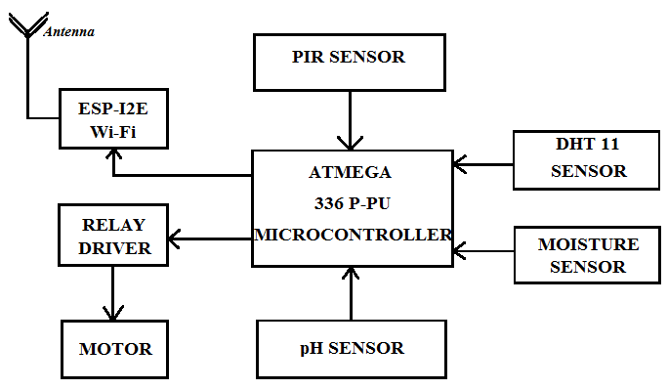
Architecture diagram

Slide 11
Novelty
The use of fully functional drones to monitor the growth of the crops.
Image capturing sensors which can detect the thermal flow and other important data regarding cultivation and giving live feed to the users

Slide 12
Modules Split up
Wi-Fi Module
Digital Sensing components
Analog Sensing component
Microcontroller
Data Reception and alert processing
Cloud Storage

Slide 13
Modules Description
1. Wi-Fi Module
The module supports standard IEEE802.11 b/g/n agreement, complete TCP/IP protocol stack. Users can use the add modules to an existing device networking, or building a separate network controller. ESP8266 is high integration wireless SOCs, designed for space and power constrained mobile platform designers. It provides unsurpassed ability to embed Wi-Fi capabilities within other systems, or to function as a standalone application, with the lowest cost, and minimal space requirement.

Slide 14
Features of Wi-Fi Module:
• 802.11 b/g/n
• Integrated low power 32-bit MCU
• Integrated 10-bit ADC
• Integrated TCP/IP protocol stack
• Integrated TR switch, balun, LNA, power amplifier and matching network
• Integrated PLL, regulators, and power management units
• Supports antenna diversity

Slide 15
2. Digital Sensing components
Since the project is mainly based on 3 different types of sensors, a brief description of them are required. Each one performs their own individual operations; the three different types of sensors used are PIR Sensor, Humidity and Temperature level Sensor and Water level sensor.

Slide 16
3. Analog Sensing component
The only analog component to be used here is the pH level sensor. Since it is the sole analog component, an A/D convertor is used along with it. This sensor notes the pH level of the soil and then its data is converted from analog to digital using the A/D convertor.
The pH sensor regulates values from 0-7 from its scale of acidic to neutral levels.

Slide 17
4. Microcontroller
ATmega-328 is basically an Advanced Virtual RISC (AVR) micro-controller. It supports the data up to eight (8) bits. ATmega-328 has 32KB internal built in memory. This micro-controller has a lot of other characteristics.
ATmega-328 has 1KB Electrically Erasable Programmable Read Only Memory (EEPROM). This property shows if the electric supply supplied to the micro-controller is removed, even then it can store the data and can provide results after providing it with the electric supply. Moreover, ATmega-328 has 2KB Static Random Access Memory (SRAM).

Slide 18
5. Data Reception and alert processing
A) Data Reception:
Once all the sensors are correlated, then these sensors collect the respective data and show them to the project link which comes by the address, www.smartagroids-iot.science . All the necessary information is shown in the main page for every automatic refresh period of 20 seconds.
The data can be retrieved from the cloud storage with the access of the server administrator.
B) Alert Processing:
Alert system only acts for two processes. One is for the reduction of the water level and the other is for the intrusion detection. If any of the following occurs, then an alert is passed and a pop-up will be shown.

Slide 19
6. Cloud Storage
Cluster storage is the format of maintaining the data set of the sensors, different levels of them and related sorts of data as a table in the data base.

Slide 20
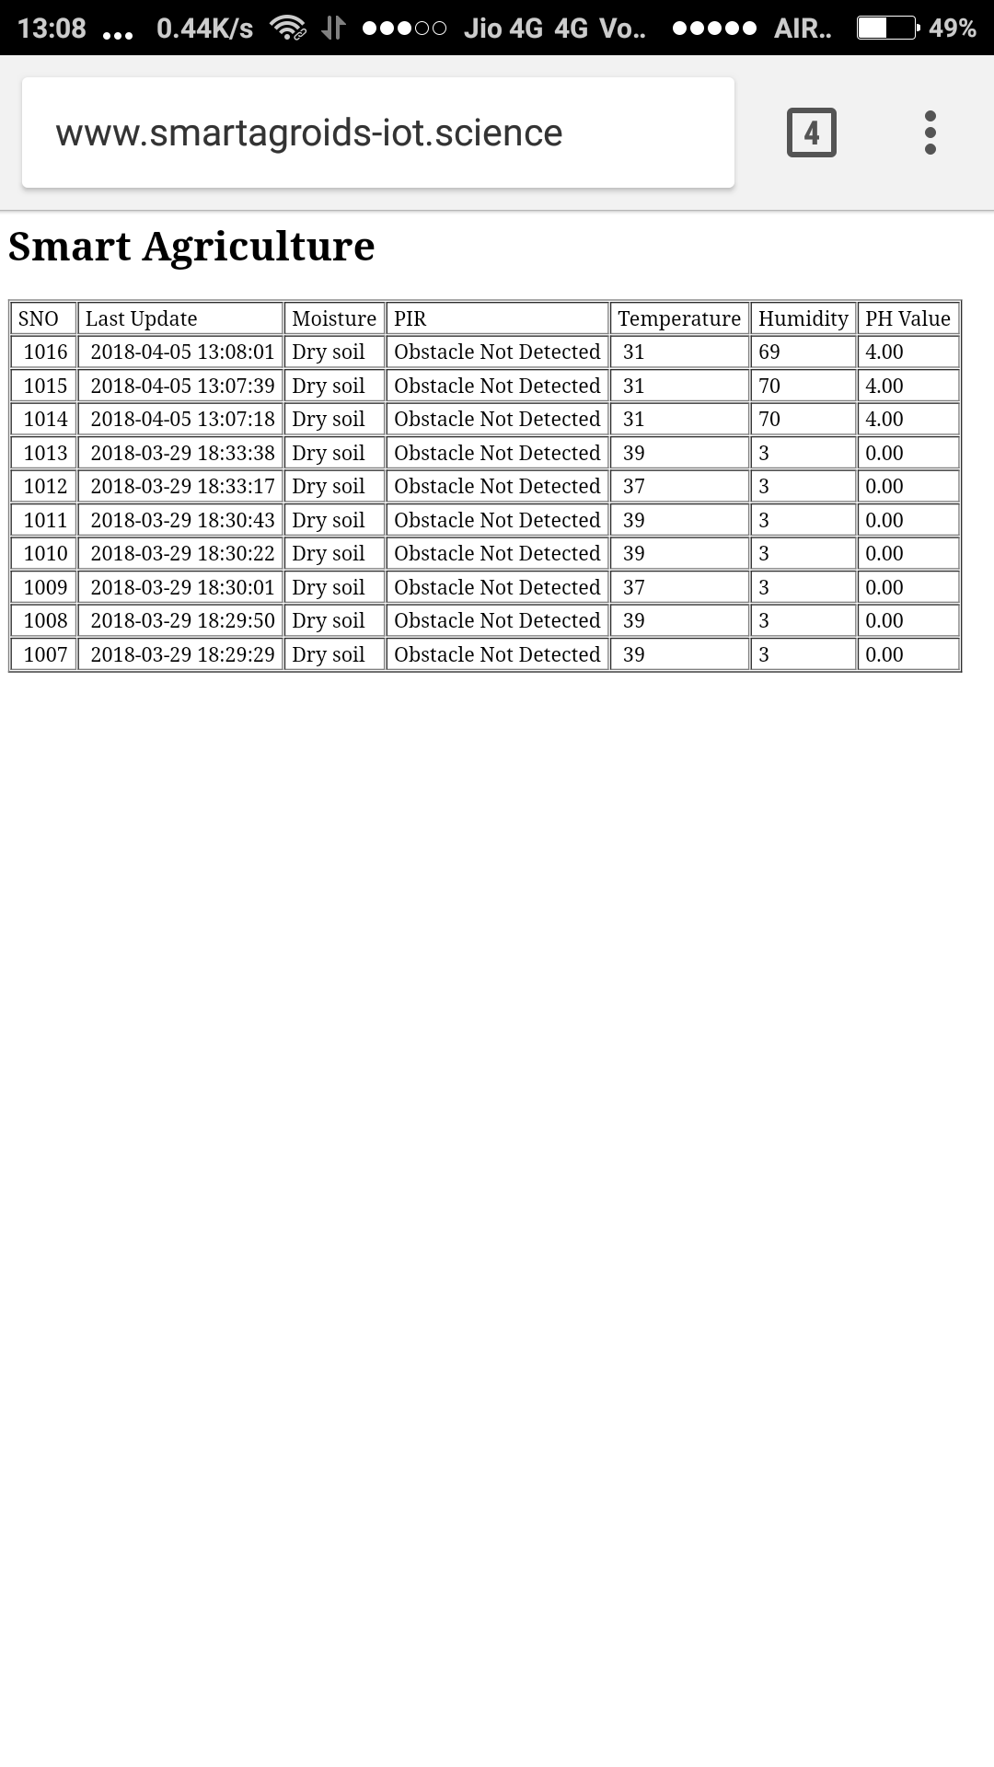
Snapshots
Humidity value at normal level

Slide 21
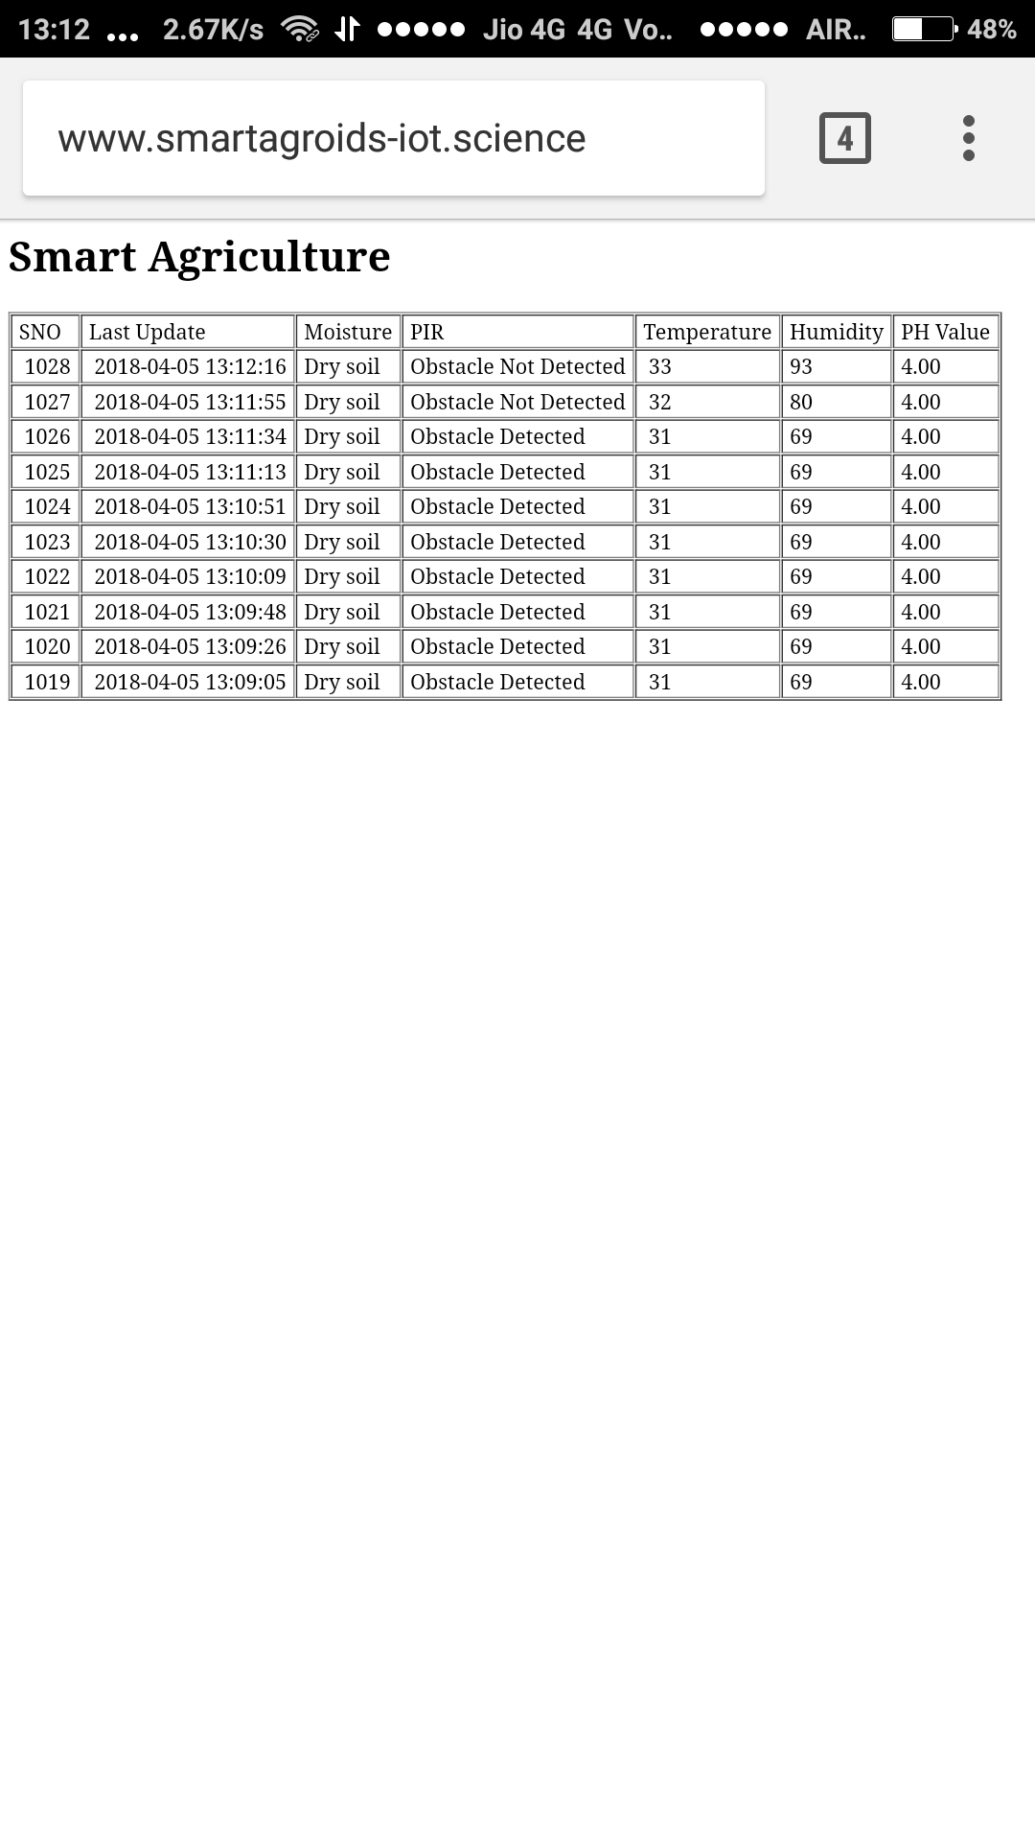
Humidity level when changed

Slide 22
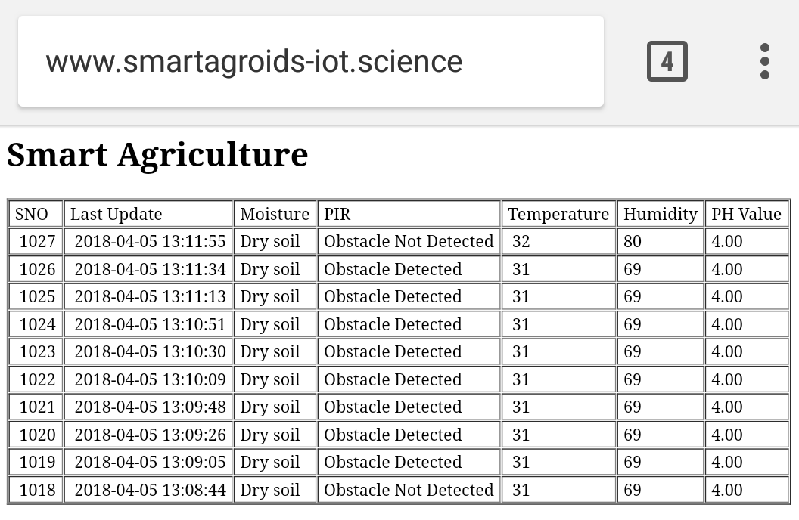
Reading before Temperature Change

Slide 23
Increase in Level of Temperature

Slide 24
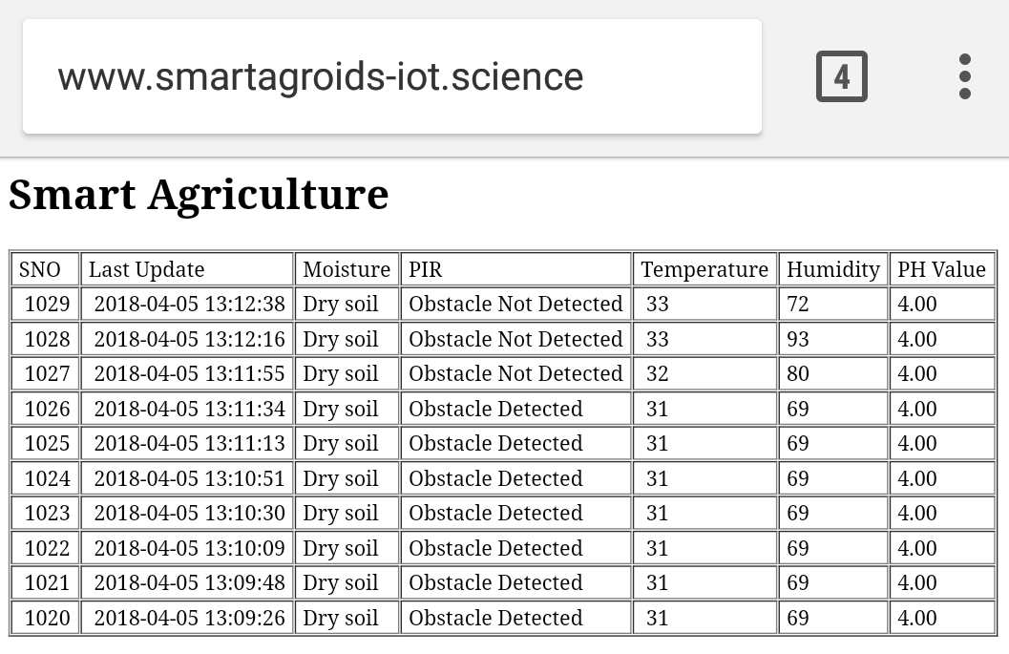
No detection in Obstacle

Slide 25
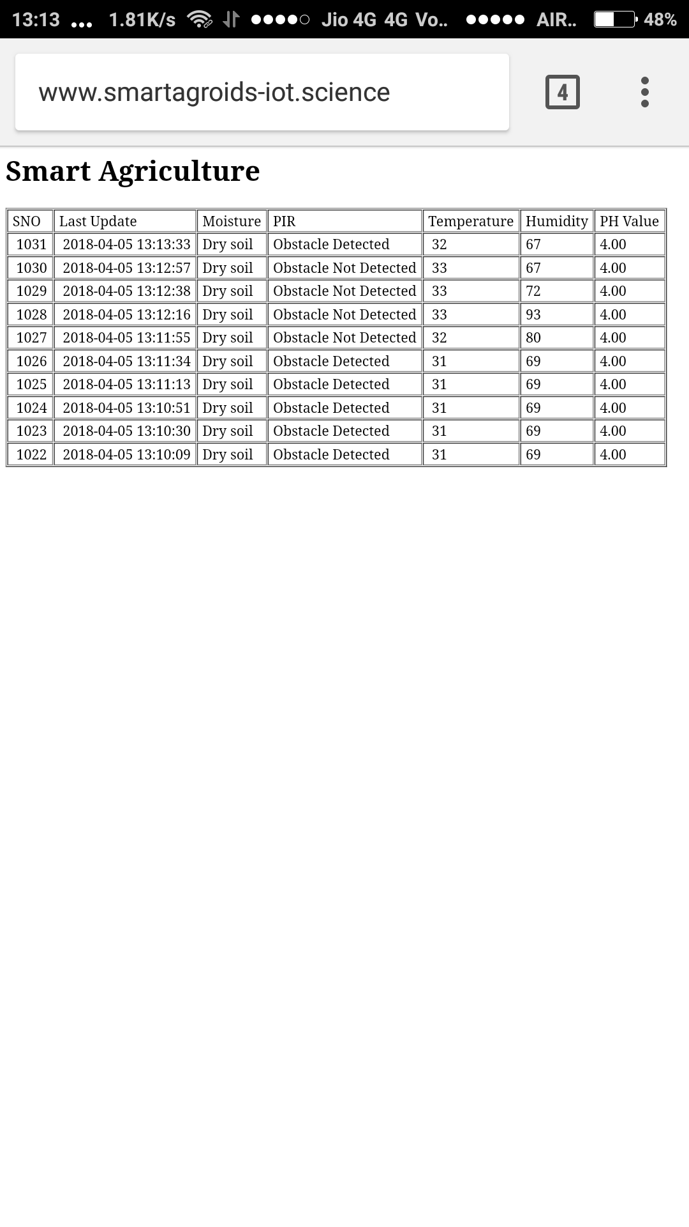
Detection of an obstacle

Slide 26
pH at normal level

Slide 27
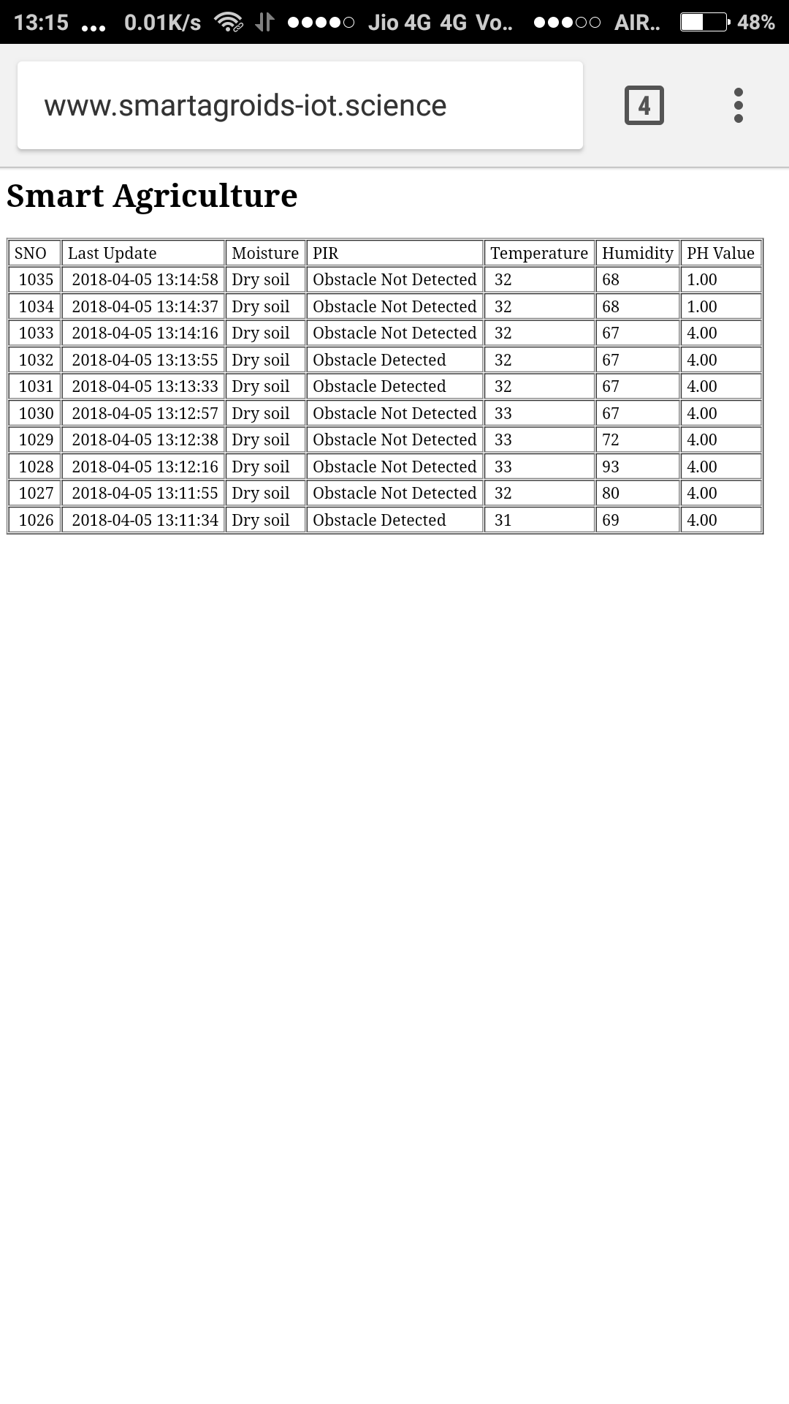
pH at “1” when urea is low

Slide 28
Water not present in the soil

Slide 29
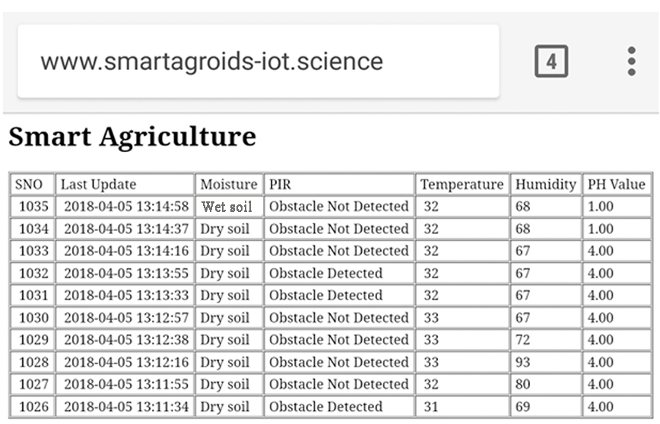
Water present in soil

Slide 30
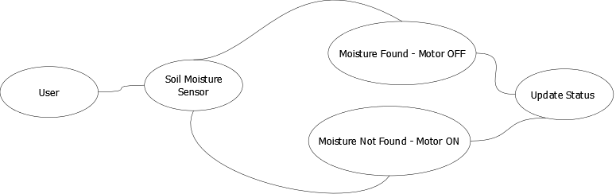
Data Flow Diagrams
DFD LEVEL 0

Slide 31
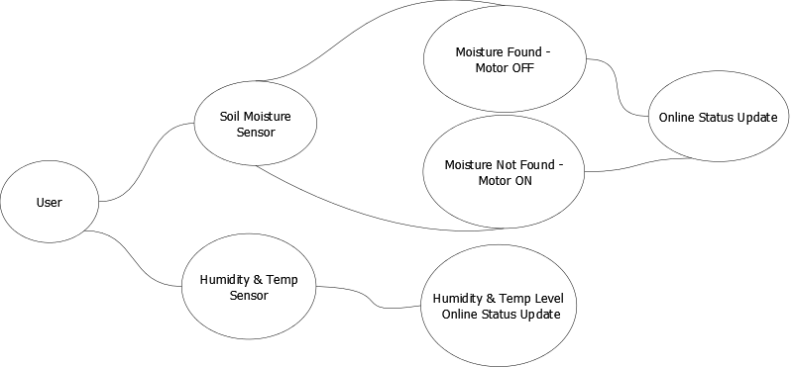
DFD LEVEL 1

Slide 32
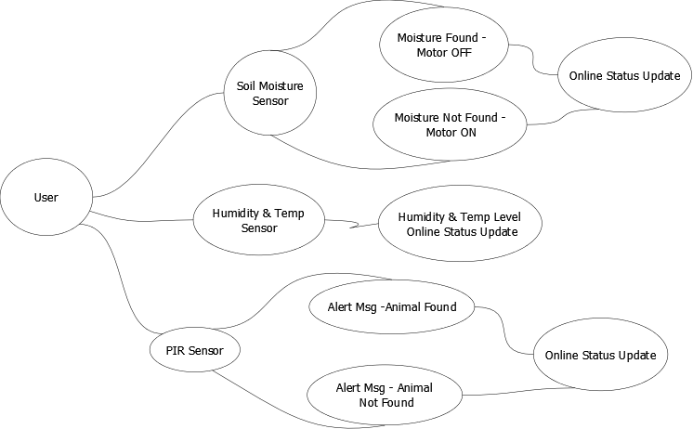
DFD LEVEL 2

Slide 33
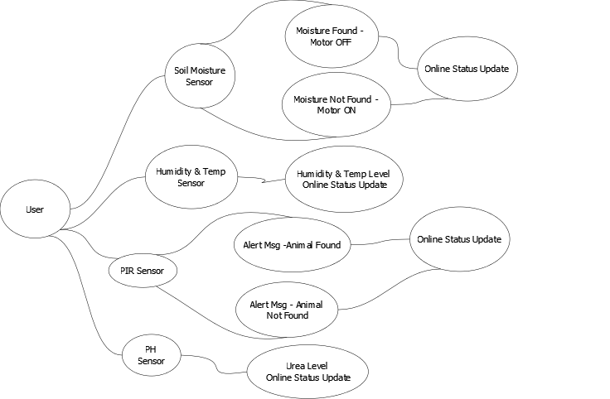
DFD LEVEL 3

Slide 34

Of the many advantages IoT brings to the table, its ability to innovate the landscape of current farming methods is absolutely groundbreaking.
IoT sensors capable of providing farmers with information about crop yields, rainfall, pest infestation, and soil nutrition are invaluable to production and offer precise data which can be used to improve farming techniques over time.
New hardware, like the corn-tending Robot, is making strides by pairing data-collecting software with robotics to fertilize the corn, apply seed cover-crops, and collect information in order to both maximize yields and minimize waste.

Slide 35
Publication details
Paper title : Authors : Journal Name : Edition : MONTH & YEAR : | SMART AGRICULTURE MONITORING SYSTEM BASED ON IOT Mr. P.V. RAO M.E, (Ph.D.,), ANURAAG. K, ARAVINTH. V, ARUN DAVID. M, ARUN. E INTERNATIONAL RESEARCH JOURNAL OF ENGINEERING AND TECHNOLOGY (IRJET) VOLUME 5 ISSUE 3 SL. NO: 442 e-ISSN: 2395-0056, p-ISSN: 2395-0072 MARCH 2018

Slide 36
References
[1] A.R. Sepaskhah, S.H. Ahmadi, “A review on partial rootzone drying irrigation. International Journal of Plant Production”, October 2010.
[2] Chetan Dwarkani M, Ganesh Ram R, Jagannathan S, R. Priyatharshini, “Smart Farming System Using Sensors for Agricultural Task Automation”, IEEE International Conference on Technological Innovations in ICT for Agriculture and Rural Development (TIAR 2015).
[3] C. Liu, W. Ren, B. Zhang, and C. Lv, “The application of soil temperature measurement by lm35 temperature sensors,” International Conference on Electronic and Mechanical Engineering and Information Technology, vol. 88, no. 1, pp. 1825–1828, 2011.
[4] D.D.Chaudhary1, S.P.Nayse2, L.M.Waghmare, “Application of wireless sensor networks for greenhouse parameter control in precision agriculture”, International Journal of Wireless & Mobile Networks (IJWMN) Vol. 3, No. 1, February 2011.

Slide 37
[5] Dr. V .Vidya Devi,G. Meena Kumari, “Real- Time Automation and Monitoring System for Modernized Agriculture” ,International Journal of Review and Research in Applied Sciences and Engineering (IJRRASE) Vol3 No.1. PP 7-12, 2013.
[6] Ji-woong Lee, Changsun Shin, Hyun Yoe, ”An Implementation of Paprika Green house System Using Wireless Sensor Networks”, International Journal of Smart Home Vol.4, No.3, July, 2010.
[7] Joaquín Gutiérrez, Juan Francisco Villa-Medina, Alejandra Nieto-Garibay, and Miguel Ángel Porta- Gándara, “Automated Irrigation System Using a Wireless Sensor Network and GPRS Module”, IEEE Transactions on Instrumentation and Measurements, 0018-9456,2013.
[8] K.Lakshmisudha, Swathi Hegde, Neha Kale, Shruti Iyer,“ Smart Precision Based Agriculture Using Sensors”, International Journal of Computer Applications (0975-8887), Volume 146-No.11, July 2011.
[9] Mahesh M. Galgalikar, “Real-Time Automization Of Agricultural Environment for Social Modernization of Indian Agricultural System”, 978- 1-4244-5586- 7/10/$26.00 C 2010 IEEE.

Slide 38
[10] Meonghun Lee, Jeonghwan Hwang, Hyun Yoe, “Agricultural Protection System Based on IoT”, IEEE 16th International Conference on Computational Science and Engineering, 2013.
[11] M.K.Gayatri, J.Jayasakthi, Dr.G.S.Anandhamala, “Providing Smart Agriculture Solutions to Farmers for better Yielding Using IoT”, IEEE International Conference on Technological Innovations in ICT for Agriculture and Rural Development (TIAR 2015).
[12] Monika Jhuria, Ashwani Kumar, Rushikesh Borse, “Image Processing for Smart Farming: Detection of Disease and Fruit Grading”, IEEE Second International Conference on Image Information Processing (ICIIP),
2013.
[13] Nikesh Gondchawar, Dr. R.S.Kawitkar, “IoT Based Smart Agriculture”, International Journal of Advanced Research in Computer and Communication Engineering (IJARCCE), Vol.5, Issue 6, June 2016.
[14] Orazio Mirabella and Michele Brischetto, “A Hybrid Wired/Wireless Networking Infrastructure for Greenhouse Management”, IEEE Transactions on Instrumentation and Measurement, vol. 60, no. 2, pp 398- 407, 2011.

